Slide 1
IF3141
SISTEM INFORMASI
Programming & Development Approaches
Semester 2 2024/2025
IF3141 | TEKNIK INFORMATIKA ITB

Slide 2
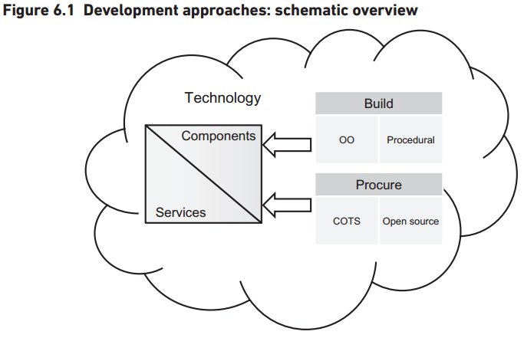
Approaches to Development
Very few systems are actually developed from the ground up
Development teams are often merely assembling a series of ready-made components to form a solution to meet a particular set of requirements.
Notes:
Commercial off the self (COTS) adalah produk-produk yang berupa suatu paket aplikasi, sub sistem ataupun modul-modul perangkat lunak yang telah dirancang sesuai dengan suatu standard proses bisnis tertentu dan tersedia secara luas di pasar untuk dapat dipergunakan dengan modifikasi seminimal mungkin.

Slide 3
Build or Buy?
For many systems development projects, perhaps the most fundamental decision to make early on in the project is whether to procure a ready-made solution or to build a bespoke (tailor-made) solution.
Realistically, the decision to build or buy is dependent on the nature of the project being undertaken and, therefore, the type of system being sought.
Hence, the decision on which approach to take will often not be made until the system requirements have been defined and agreed.
A particular solution to a business need may be delivered through a combination of bespoke developed and ready-made components,

Slide 4
Build or Buy?
Bespoke
At one time, bespoke systems development was the only option available to organizations wishing to adopt computer technology. In more recent times, it seems that only the largest and most wealthy of organizations have the luxury of dedicated in-house development teams, and even those organizations often outsource the development work to a third-party organization.
With the bespoke development approach, a ‘tailor-made’ solution is designed and developed to precisely meet a set of agreed requirements.
Ready-made
There are two broad approaches to procuring a ready-made solution: purchase a commercial off-the-shelf (COTS) solution or obtain an open source solution.

Slide 5
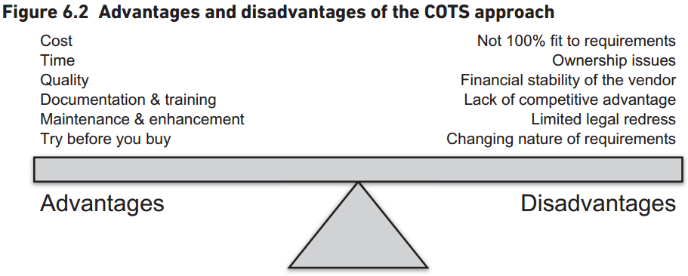
Build or Buy?
COTS
In the context of computer systems, COTS software products are ready-made software packages that are purchased, leased or licensed, off-the-shelf, by an acquirer who had no influence on its features and other qualities.

Slide 6
Build or Buy?
Open Source
The customer obtains a ready-made solution but also gains access to the source code to enable in-house or third-party developers to tailor the solution to meet the precise needs of the customer.
The open source option clearly offers a number of benefits: zero license costs (although this doesn’t mean a zero cost solution) and the provision of a ready-made solution that can also be tailored and maintained as necessary to suit the customer organization.
Notes:
System Application and Product in Data Processing (SAP) adalah software yang berbasis ERP (Enterprise Resources Planning) yang digunakan sebagai alat untuk membantu manajemen perusahaan, perencanaan, hingga melakukan operasionalnya secara lebih efektif dan efisien.

Slide 7
Component-based Development
In practice, modern information systems comprise a series of separate, but integrated, building blocks referred to as components.
A component is something that can be deployed as a black box. It has an external specification, which is independent of its internal mechanisms.
With component-based development, software applications are assembled from components from a variety of sources; the components themselves may be written in several different programming languages and run on several different platforms.

Slide 8
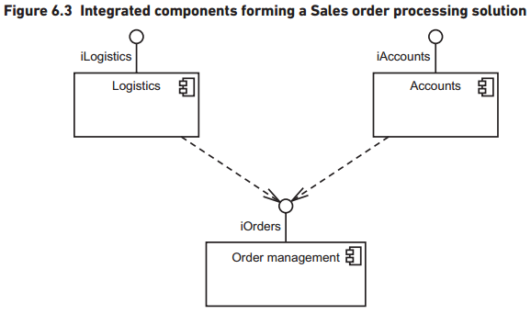
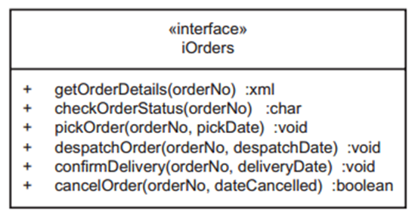
Component-based Development
Components can exist independently of each other but can also be assembled together to build new solutions; they provide services to other components and use services provided by other components
Notes:
Figure 6.3 shows three independent components: Logistics, Accounts and OrderManagement. The Logistics component exposes an interface called iLogistics, that can be used by other components to consume the services that it provides. Similarly, the Accounts component exposes an interface called iAccounts and the OrderManagement component exposes an interface called iOrders. Furthermore, Figure 6.3 shows that the Logistics and Accounts components are both using services provided by the OrderManagement component, by virtue of the fact that they have dependences on the iOrders interface (shown as dashed arrows).

Slide 9
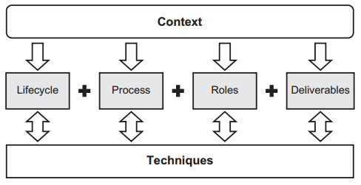
Development Methodologies

Slide 10
Development Methodologies
Systems development processes broadly fall in to one of two categories: ‘defined’ or ‘empirical’.
Defined Process
The premise behind a defined process is that each piece of work can be completely understood and that, given a well-defined set of inputs, the same outputs are generated every time.
Useful when the underlying mechanisms by which a process operates are reasonably well understood
Common defined (procedural) methodology and framework: SSADM, Structured Analysis, Structured Design, Yourdon Structured Method, Information Engineering, SADT, SSM, Structured Programming, JSP, IDEF0, Structured Methods, UP
Notes:
The steps are already known

Slide 11
Development Methodologies
Empirical Process
The problem with applying defined processes to the discipline of systems development is that defined processes are based on the premise that the product being built is always the same and, hence, the process is predictable and repeatable.
In fact, systems development more closely resembles research and development of new products, which is more of an empirical process. Hence, the recent trend towards ‘Agile’ development, which is based upon an empirical process model.
A process that cannot be repeated due to the inherent complexity needs to adopt this mechanism.
Common empirical approach: RAD, Agile (XP, DSDM, Scrum, Adaptive software development, Crystal clear, Lean systems development, Test-driven development, Feature-driven development, Kanban, Agile UP)

Slide 12
Software Engineering Paradigms
A number of different paradigms (world views underlying the theories and methodology of software engineering and programming) have evolved since the early 1960s, each proposing a radically different approach to building software.
Three most prevalent paradigms that underpin modern software development:
Structured programming
Object-oriented programming
Service-oriented development
Please explore it independently!

Slide 13
The Influence of Technological Advances
Advances in technology provide opportunities for software developers that enable them to deliver significant business benefits.
Sometimes these benefits manifest themselves in cheaper and quicker solution development, whilst others are more far-reaching and can actually revolutionize the provision of IT solutions for the entire IT industry.
Two such technological advances are:
Cloud-based
Model Driven Architecture (MDA)

Slide 14
The Influence of Technological Advances
Cloud-based
‘a model for enabling convenient, on-demand network access to a shared pool of configurable computing resources […] that can be rapidly provisioned and released with minimal management effort or service provider interaction.’ (NIST)
Cloud computing consists of three separate types of service:
Software as a service (SaaS) – the provision of applications in the cloud.
Platform as a service (PaaS) – the provision of services that enable the customer to deploy applications in the cloud using tools provided by the supplier.
Infrastructure as a service (IaaS) – the provision of computing power, storage and network capacity that enable the customer to run software (including operating systems and applications) in the cloud.

Slide 15
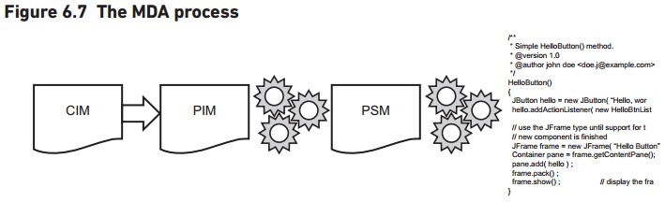
The Influence of Technological Advances
Model Driven Architecture (MDA)
Model Driven Architecture refers to an approach to the production of executable software directly from a set of design models, without the intervention of a human programmer.
A major advantage of this approach, from the perspective of the development team, is that the model and the physical system it represents are kept synchronized.
Notes:
The start point is an abstract computer-independent model (CIM). This is essentially a conceptual model of a business domain that captures the key requirements of a new computer system. The CIM is then used as a basis for developing a platform independent model (PIM). The PIM is based on the main analysis models expressed using UML notation and represents the business functionality and behaviour without the constraints of technology. The PIM is then converted into a platform-specific model (PSM), which takes into account the software and hardware environment that the solution is to be implemented in. Finally, the PSM is used to generate the actual executable program code.

